Slide 1
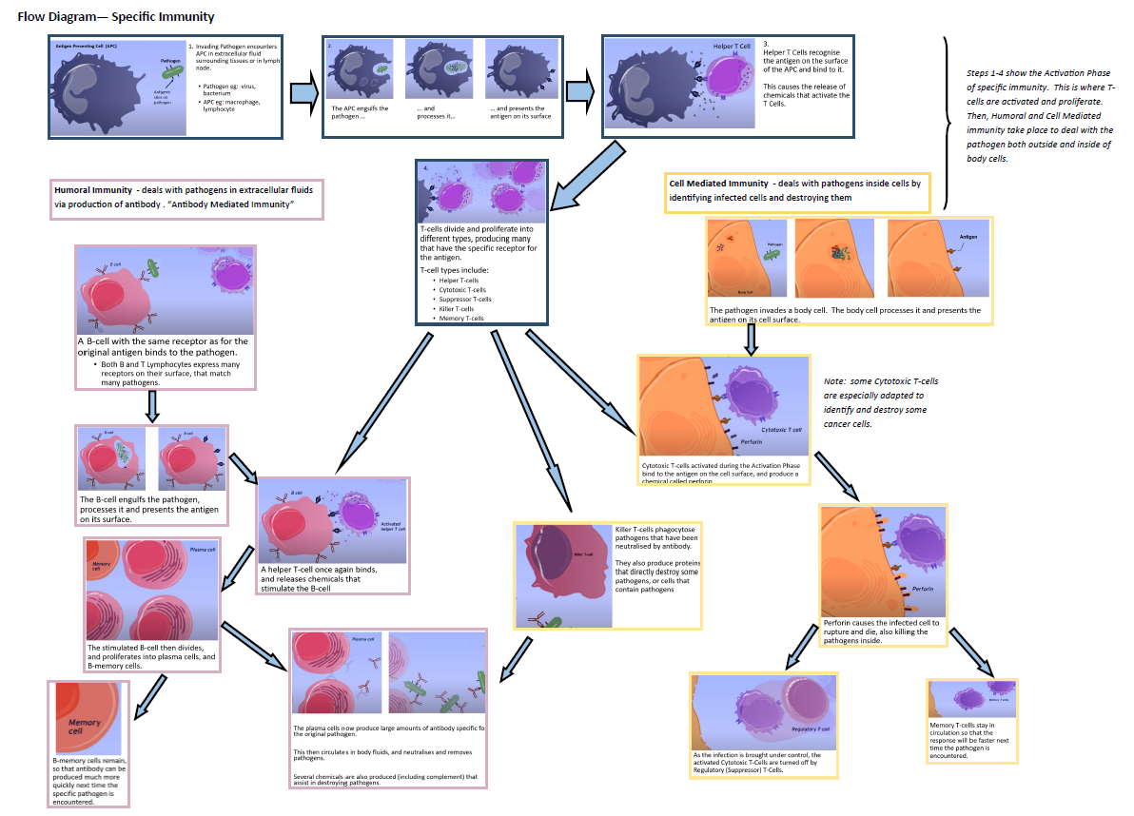

Slide 2
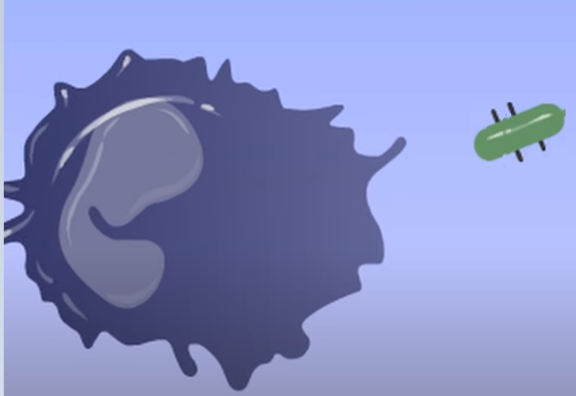
Antigen Presenting Cell (APC)
Invading Pathogen encounters APC in extracellular fluid surrounding tissues or in lymph node.
Pathogen eg: virus, bacterium
APC eg: macrophage, lymphocyte
Pathogen
Antigenic sites on pathogen

Slide 3
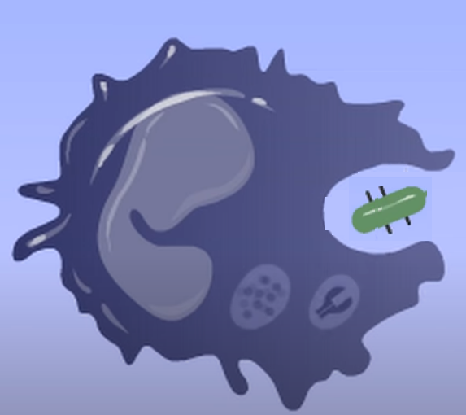
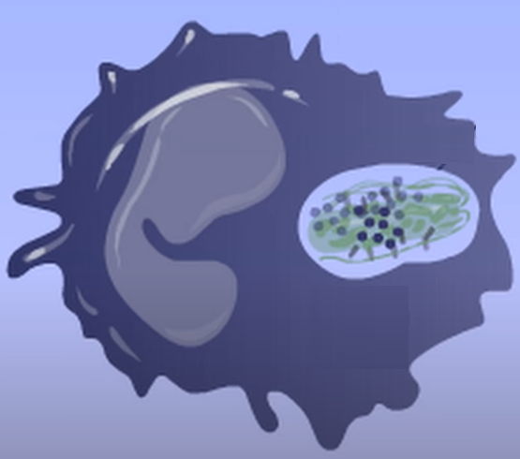
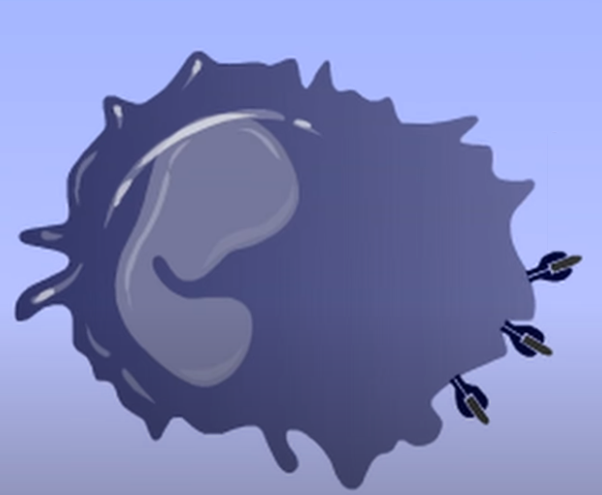
2.
The APC engulfs the pathogen …
... and processes it…
… and presents the antigen on its surface

Slide 4
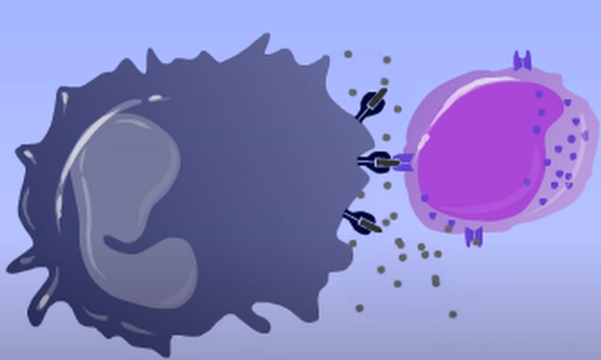
Helper T Cell
3. Helper T Cells recognise the antigen on the surface of the APC and bind to it. This causes the release of chemicals that activate the T Cells.

Slide 5
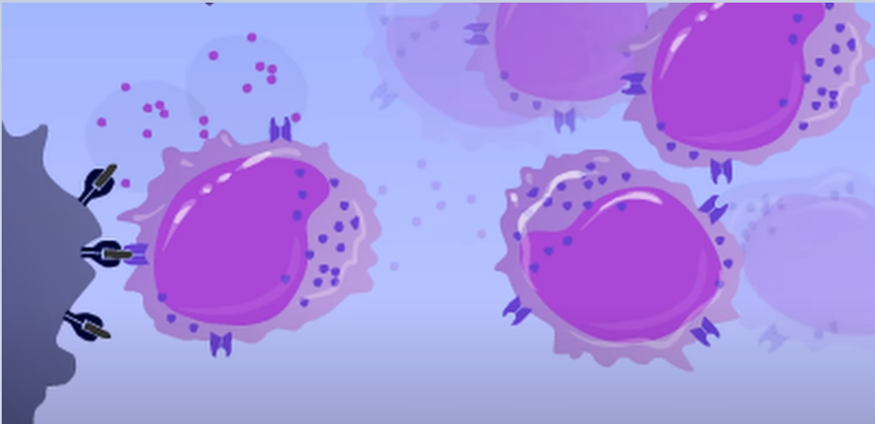
4.
T-cells divide and proliferate into different types, producing many that have the specific receptor for the antigen.
T-cell types include:
Helper T-cells
Cytotoxic T-cells
Suppressor T-cells
Killer T-cells
Memory T-cells

Slide 6
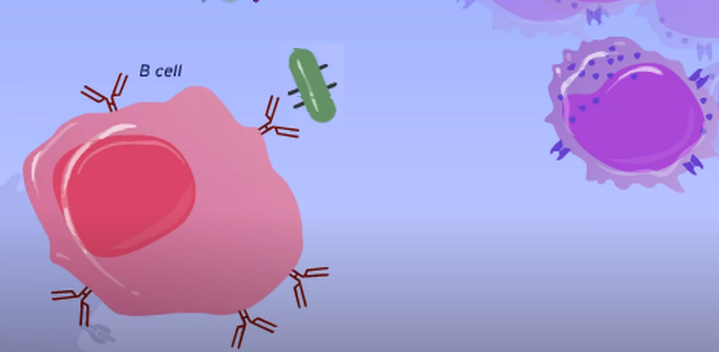
1. B-cell with the same receptor as for the original antigen binds to the pathogen.
Both B and T Lymphocytes express many receptors on their surface, that match many pathogens.

Slide 7
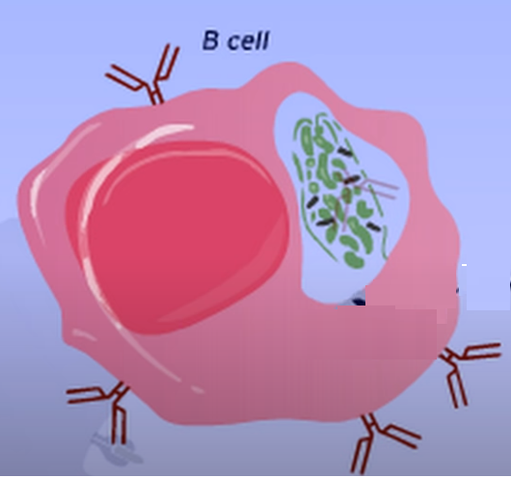
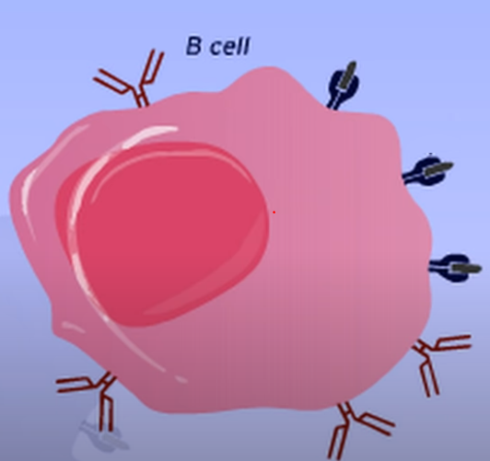
2. The B-cell engulfs the pathogen, processes it and presents the antigen on its surface.

Slide 8
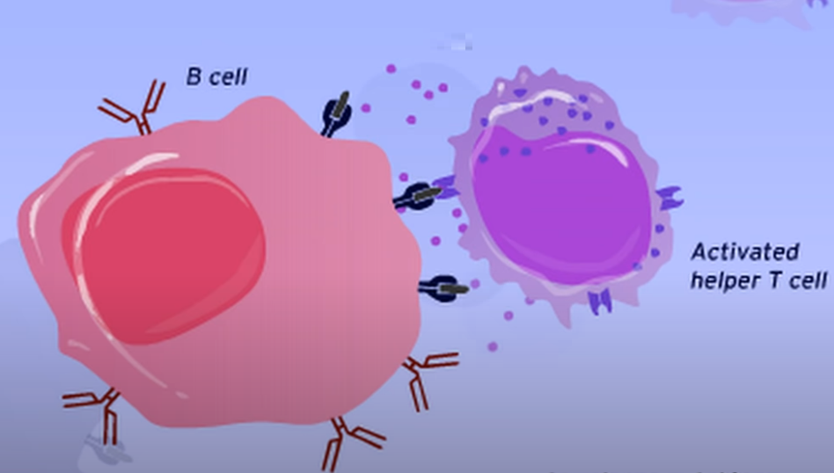
3. A helper T-cell binds, and releases chemicals that stimulate the B-cell

Slide 9
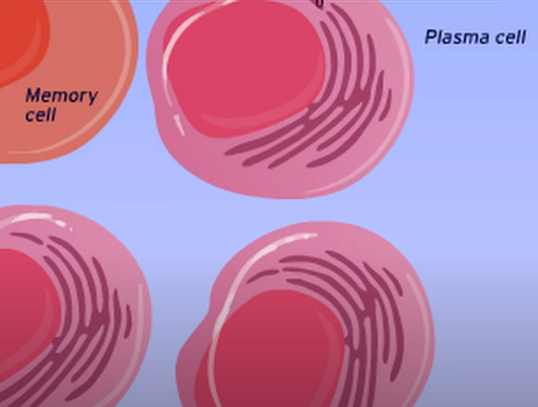
4. The stimulated B-cell then divides, and proliferates into plasma cells, and B-memory cells.

Slide 11
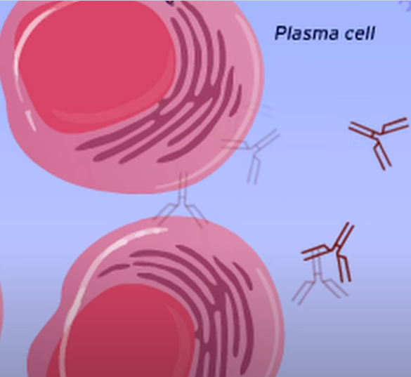
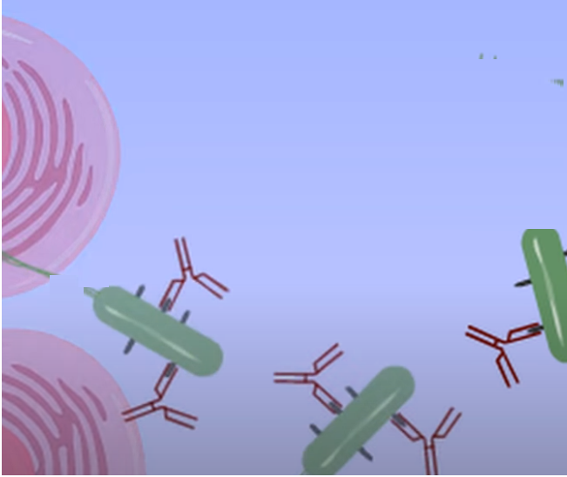
The plasma cells now produce large amounts of antibody specific for the original pathogen.
This then circulates in body fluids, and neutralises and removes pathogens.
Several chemicals are also produced (including complement) that assist in destroying pathogens.

Slide 12
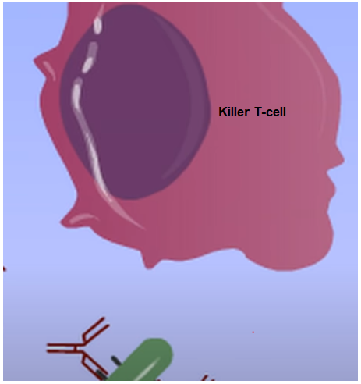
Killer T-cells phagocytose pathogens that have been neutralised by antibody. They also produce proteins that directly destroy some pathogens, or cells that contain pathogens

Slide 13
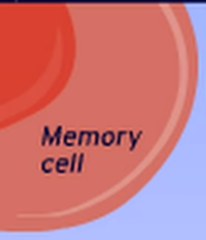
B-memory cells remain, so that antibody can be produced much more quickly next time the specific pathogen is encountered.

Slide 14
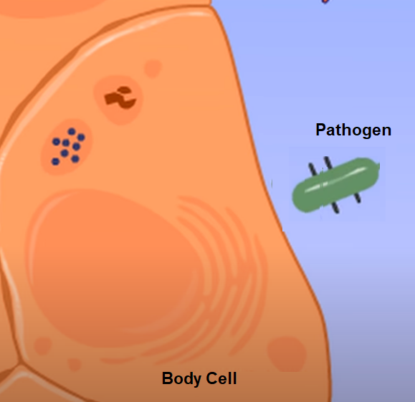
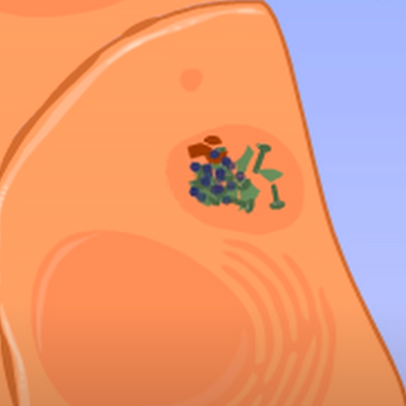
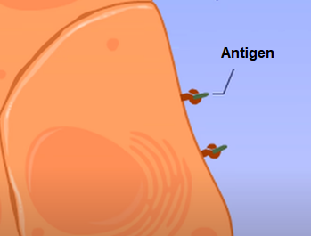
The pathogen invades a body cell. The body cell processes it and presents the antigen on its cell surface.

Slide 15
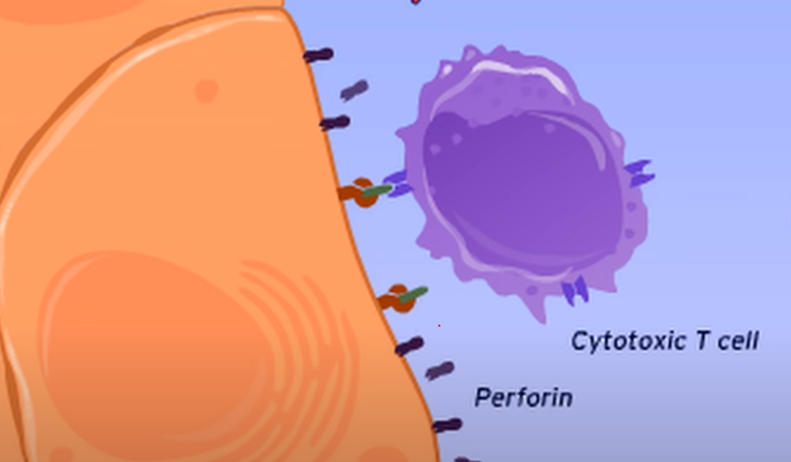
Cytotoxic T-cells activated during the Activation Phase bind to the antigen on the cell surface, and produce a chemical called perforin

Slide 16
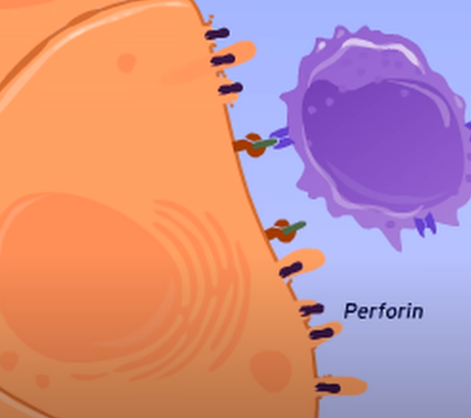
Perforin causes the infected cell to rupture and die, also killing the pathogens inside.

Slide 17
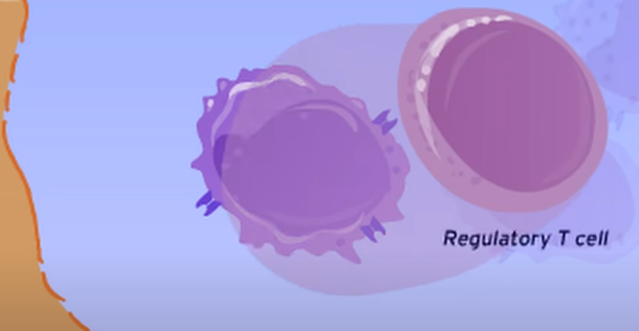
As the infection is brought under control, the activated Cytotoxic T-Cells are turned off by Regulatory (Suppressor) T-Cells.

Slide 18
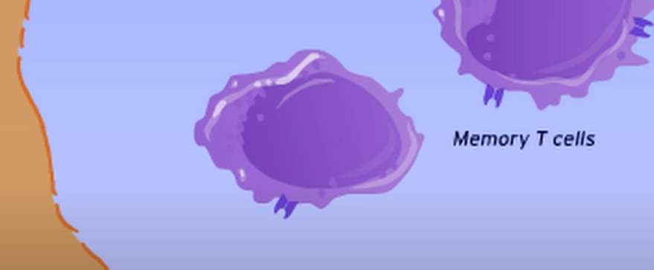
Memory T-cells stay in circulation so that the response will be faster next time the pathogen is encountered.

Slide 19


